Slide 1
GI Lecture: Colon and Rectal Disorders
Erik Hollers, PA-C – Moffitt Cancer and Research Center
Lincoln Memorial University - Tampa
Clinical Medicine II
Summer 2026

Slide 2
Course Objectives
Explain the epidemiology, etiology, pathophysiology, clinical presentation, diagnostic findings, and treatment of Diseases of the Colon and Rectum.
Explain the epidemiology, etiology, pathophysiology, clinical presentation, diagnostic findings, and treatment of Diseases of the Anorectum including
Explain the epidemiology, etiology, pathophysiology, clinical presentation, diagnostic findings, and treatment of Diseases of the Liver
Explain the epidemiology, etiology, pathophysiology, clinical presentation, diagnostic findings, and treatment of Diseases of the Biliary Tract
Explain the epidemiology, etiology, pathophysiology, clinical presentation, diagnostic findings, and treatment of Diseases of the Pancreas

Slide 3
Course Objectives
Apply knowledge of GI anatomy and physiology when taking a patient’s history, performing a physical examination, and developing a treatment plan, considering age-related changes
Differentiate between normal and abnormal gastrointestinal exam findings to guide and support medical decisions and treatment plans.
Analyze abnormal findings to develop a relevant differential diagnosis utilizing a system based pathophysiological model.
Interpret common GI laboratory and diagnostic tests/screenings (including selection of appropriate tests and interpretation of age-appropriate reference ranges).
Select appropriate patient-centered treatment plans for gastroenterology disorders that incorporate evidence-based non-pharmacologic and pharmacologic interventions, considering patient preferences, values, and cultural beliefs.
Develop professional, culturally sensitive, empathetic, comprehensive acute and chronic care plans for patients of all ages, incorporating preventive care, education, referrals, and rehabilitation coordination.

Slide 4

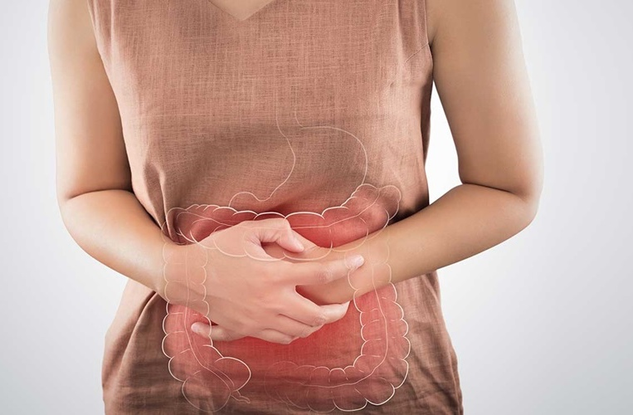
Constipation: Overview/Clinical Manifestations
Constipation: usually refers to passing less than 3 stools per week
Can also include difficulty passing stools, hard stools, and/or incomplete evacuation
Always remember, everyone has different bowel habits
Etiologies: multi-variable
Dietary habits
Motor Disorders: DM, hypothyroid, Colorectal Ca, Celiac Disease
MEDS: many medications cause constipation (OPIOIDS, Zofran, Verapamil etc.)

Slide 5
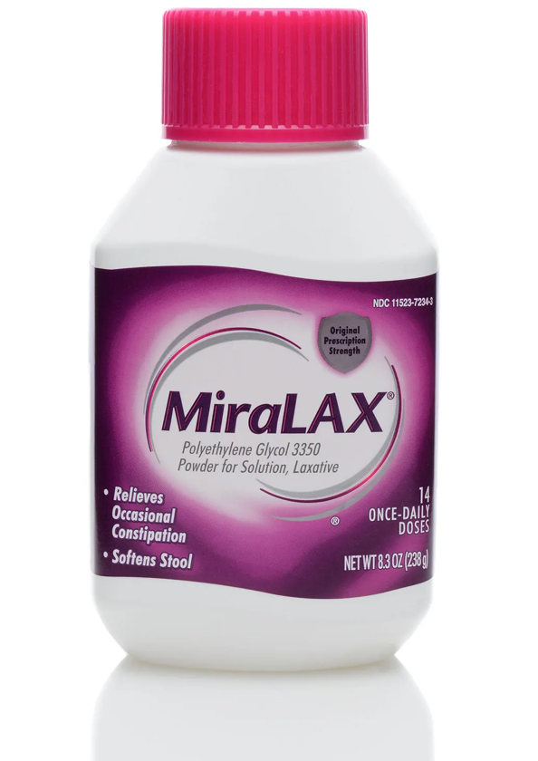
Constipation: Management
First line is always diet modifications: High Fiber diet – helps retain water and forms more bulky stools
Medical Management:
Bulk Forming Laxatives: absorbs water and increases fecal matter (Psyllium, Methylcellulose, Polycarbophil, Wheat Dextron)
Usually used in combination with high fiber diet
Osmotic Laxatives: causes water retention in stool (synthetic sugars – Lactulose, Sorbitol)
PEG (Polyethylene Glycol) – MiraLAX
Synthetic Sugars: Lactulose, Sorbitol
Saline Laxatives: Milk of Magnesia, Magnesium Citrate
Stimulant Laxatives: increases acetylcholine-regulated GI motility (increases peristalsis) include Senna and Bisacodyl
All medications have the potential for side effects: diarrhea, abdominal cramping, and or increased gas pressure
Use a step-wise approach. Never add multiple lines of medications all oat once.
Same caution for tapering: never taper all at once, can cause refractory constipation issues.

Slide 6

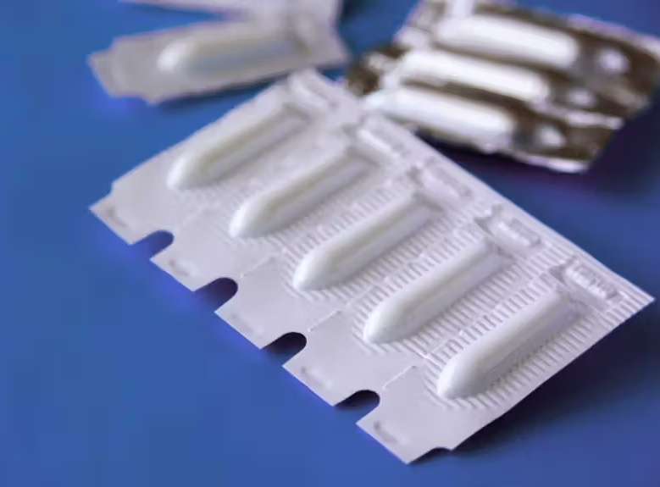
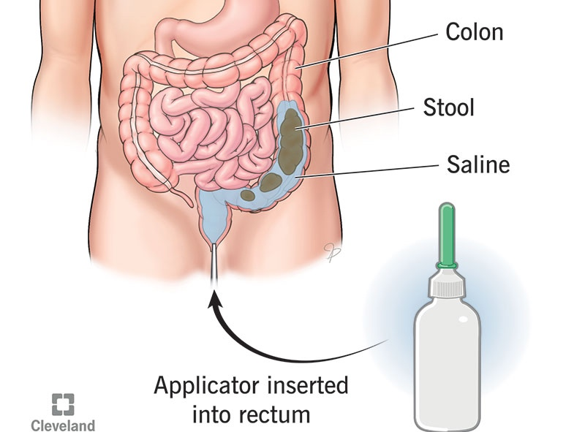
Constipation: Management
Other modalities for management include:
Surfactant/Stool Softeners (Docusate sodium – typically combined with Senna). Used to lower surface tension of stool causing water to enter stool easily.
Enemas and Suppositories: generally reserved with patient with severe symptoms and/or have had a recent fecal impaction to prevent recurrence.
Glycerin or Bisacodyl Suppositories (osmotic effect)
Enemas: favor tap water or sodium phosphate (correlation with electrolyte abnormalities and volume depletion)

Slide 7
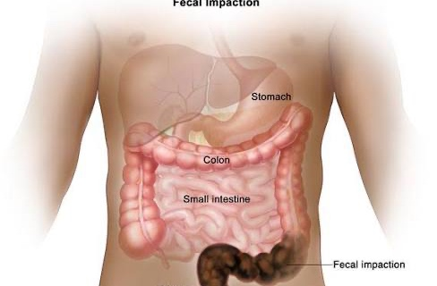
Constipation: Fecal Impaction
Fecal Impaction: a solid immobile bulk of stool in the rectum
Typically caused by decreased mobility of fecal matter
Severe abdominal pain
Heavy stool burden via x-ray
First Line Treatment: Fecal Disimpaction
Manual disimpaction followed by colon evacuation with enemas (using PEG electrolytes solution)
If unsuccessful, will need to proceed water contrast enema (Gastrografin or Hypaquue) to be administered under fluoroscopy
After disimpaction: colon evacuation recommended. Daily MiraLAX or using warm enemas for up to 3 days.
To Prevent Recurrence: add Sorbitol, Lactulose, and or MiraLAX with goal of having at least one stool every other day

Slide 8
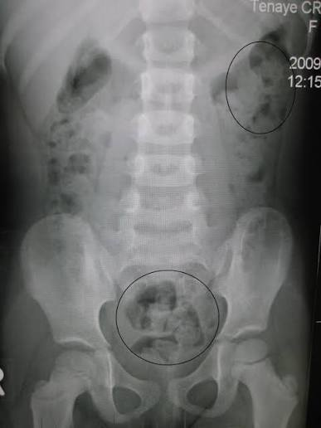
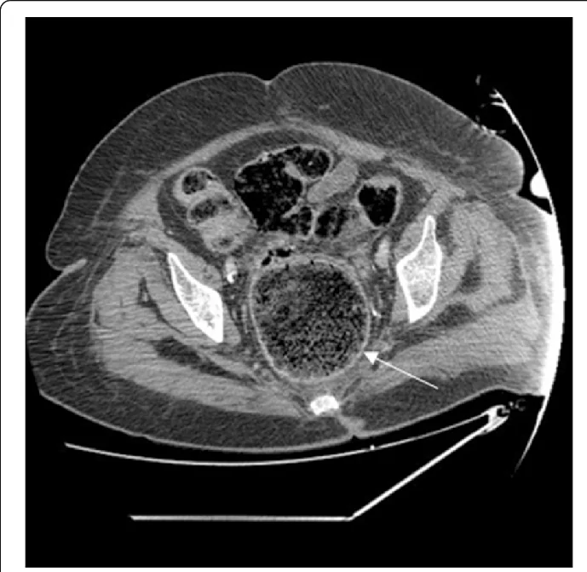
Constipation: Fecal Impaction

Slide 9

Fecal Incontinence: Overview
Fecal Incontinence: involuntary loss of solid or liquid feces
Common Risk Factors: age, diarrhea, fecal urgency, urinary incontinence, DM, and central adiposity
Etiologies:
Acute Diarrhea (most common) – caused by illness from infection or new medications
Neurological: sudden loss of sphincter control (spinal cord injuries – cauda equina)
Anorectal Trauma: recent childbirth or anorectal surgery
Other Medical Conditions: IBS, Neurological disease (Parkinsons, MS etc.), Diabates Mellitus

Slide 10
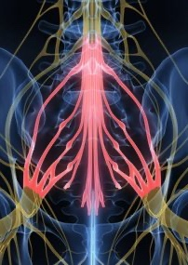
FECAL INCONTINENCE: CLINICAL MANIFESTATIONS
History very important:
Onset/Duration/Frequency/Amount
Associated symptoms (diarrhea)
Categorizing Incontinence: urge vs passive – urge characterized by the desire to defecate, but incontinence occurs despite efforts to retain stool. Passive is lack of awareness of the need to defecate.
Recognize potential patterns: nocturnal vs daytime (nocturnal suggest underlying bowel disorder of DM)
Medications/Dietary Factors
Neurological Symptoms: BE AWARE
Sudden onset of incontinence without change of bowel habits
Low back or perineal pain
Motor/Sensory symptoms in lower extremities
Urinary Incontinence

Slide 11
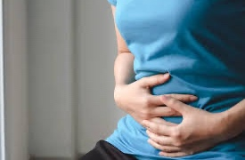
Fecal Incontinence: Clinical Manifestations
Physical Exam Findings:
Inspection of perianal area: signs of hemorrhoids, fistula, rectal prolapse
Anal Wink Sign: perianal sensation trigger anal wink reflex (absence suggest neurological process). Typically done with a cotton swab gently stroking the perianal skin towards the anus and observing contraction of anal sphincter
DRE (Digital Rectal Exam): looking for fecal impaction, tumors, assessing anal tone
Diagnostics:
Labs usually not required
Persistent incontinence usually warrants Endoscopic Procedure (Flex/Sigmoidoscopy)

Slide 12
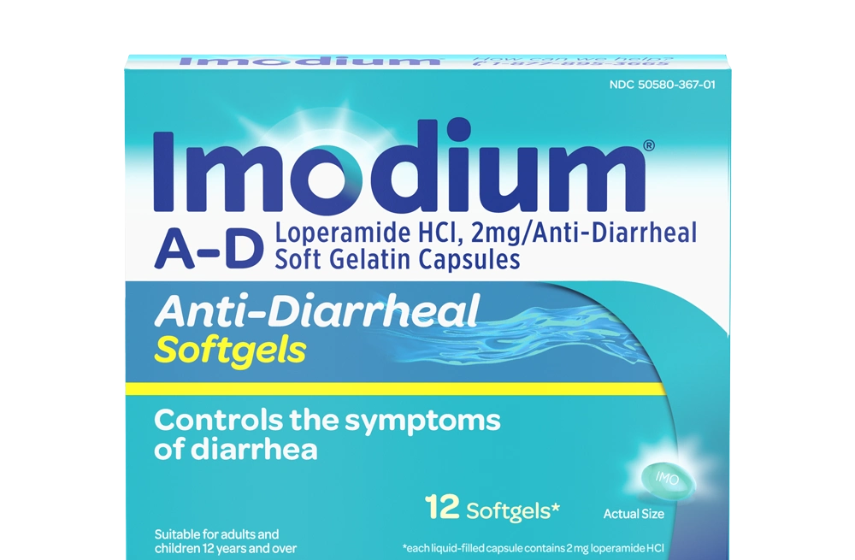
Fecal Incontinence: Management
Initial Management:
Supportive therapy first line
Avoid foods/activities that worsen symptoms
Bulking agents and antidiarrheals (Imodium) if having diarrhea
Refer to Gastroenterologist if no response to initial management
Next steps include: Biofeedback, injectable anal bulking, sacral nerve testing, anal sphincteroplasty
Refractory to above therapies, patients may required colostomy or ileostomy

Slide 13
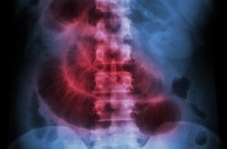
Paralytic (Adynamic) Ileus: Overview
Ileus: functional obstruction – paralytic (adynamic) ileus due to neurogenic failure of peristalsis inhibiting propel of intestinal contents
Etiologies:
Post Operative MC: this is why we tell people to get up and walk after surgery
Medications: OPIOIDS, antidiarrheals
Electrolyte Abnormalities: hypokalemia, hypercalcemia, hypomagnesemia
Other Illnesses: hypothyroidism (severe), DM

Slide 14
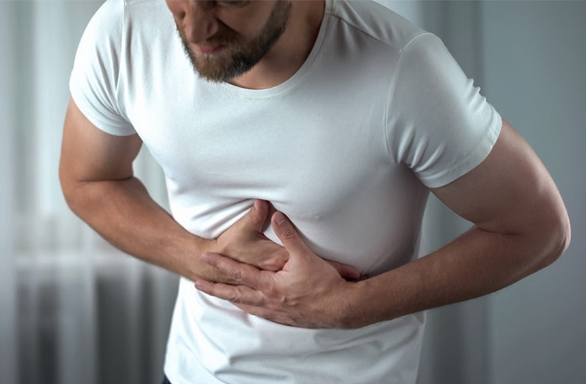
Paralytic (Adynamic) Ileus: Clinical Manifestations
Symptoms similar SBO but usually have a slower onset: abdominal pain, n/v, obstipation, distention, difficulty eating (fullness)
Physical Exam:
Decreased or absent bowel sounds
Abdominal distention and tympany
Mild tenderness to palpation

Slide 15
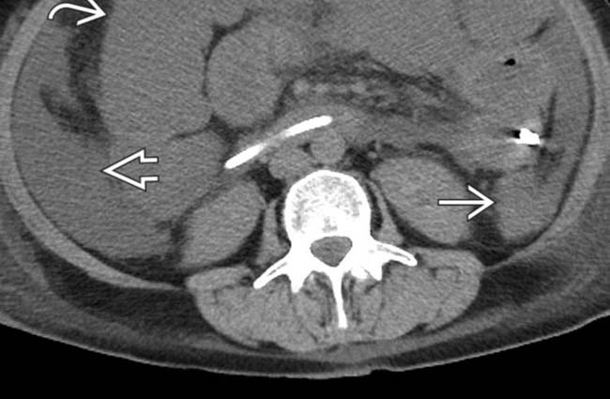
Paralytic (Adynamic) Ileus: Clinical Manifestations
Diagnostics:
Labs: CBC, electrolytes, LFTs, Amylase/Lipase
Abd X-ray: diffuse dilated bowel loops WITHOUT transition zone, paucity of air (gas) in the colon and rectum
CT A/P: CONFIRMS diagnosis - differentiates between mechanical obstruction vs ileus

Slide 16
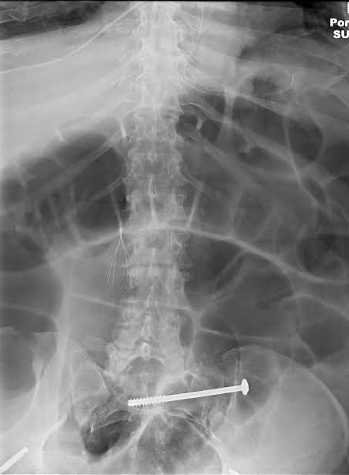
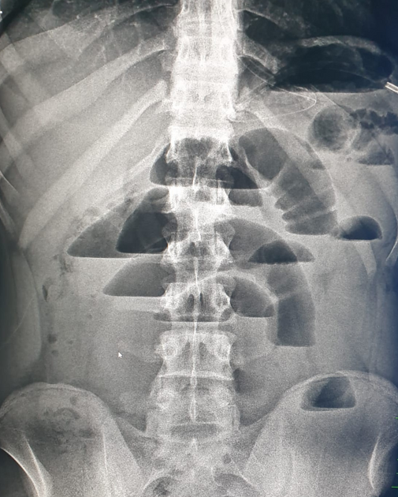
Paralytic (Adynamic) Ileus: Clinical Manifestations

Slide 17
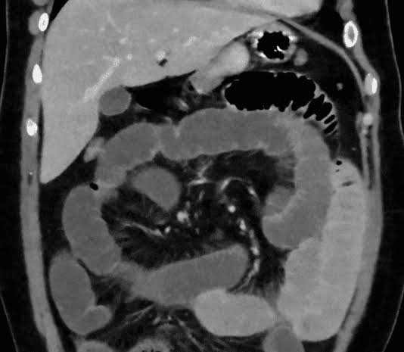
Paralytic (Adynamic) Ileus: Management
Supportive Care:
NPO (Bowel rest) – can advance diet as tolerated (usually start with clear liquid diet)
IVF, electrolyte replacement
Serial Abd Films, daily abdominal girths, symptom monitoring
NGT placement: decompression
Most post-operative Ileus resolve within 1-3 days
If persistent/worsening symptoms – perforation – peritonitis – SEPSIS!

Slide 18
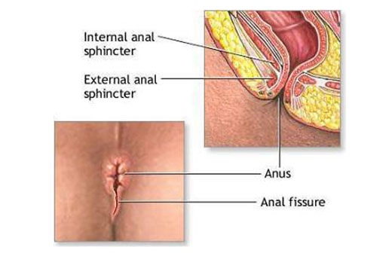
Anal Fissures: overview
Most common benign anorectal disease and one of the most common causes of anal bleeding
Often observed in infants and middle-aged adults
Etiology: local trauma d/t constipation (hard stools) most commonly. Can also be caused by diarrhea, vaginal delivery, and anal intercourse.
Typically start with tearing of the anoderm within the distal half of the anal canal. Often leads to cycle of recurring anal pain/bleeding.

Slide 19
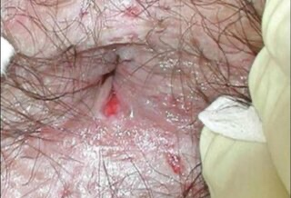
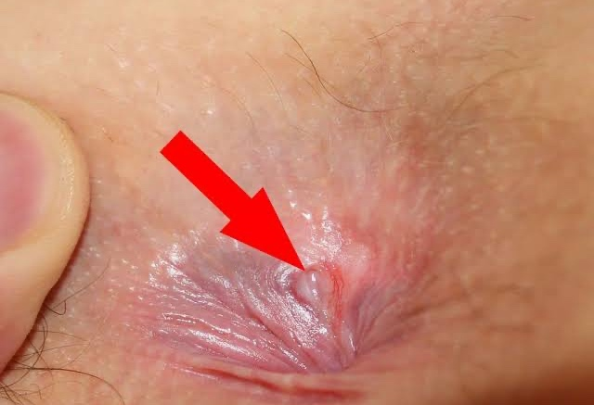
Anal Fissures: Clinical Manifestations
Anal pain exacerbated with defection
Bleeding (BRBPR/hematochezia)
Longitudinal tear in the anoderm that usually extends no more proximally than the dentate line.
90% of anal fissures located in the posterior midline of anal canal
Can be Acute or Chronic
Acute: fissure is superficial laceration (like a paper cut)
Chronic: raised edges, exposing the white/horizontally oriented fibers the internal anal sphincter muscles at the base of the fissure

Slide 20
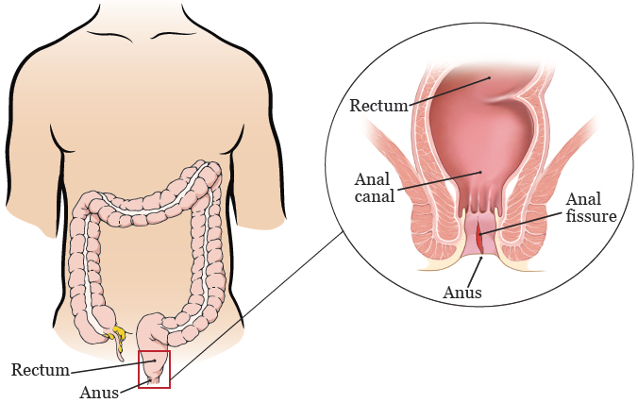
Anal Fissures: Management
Conservative Treatment:
Increased fiber diet/stool softeners
Sitz baths
Topical analgesics (lidocaine topical)
Medical Treatment:
Vasodilators (nifedipine/nitroglycerine topical ointments)
Relaxes internal anal sphincter and increases blood flow to promote healing
Typically given for about a month
Surgical Treatment:
Reserved for those who fail treatment for over two months or who have chronic changes to fissure such as fibrosis, sentinel pile, or rolled edges.
Lateral internal sphincterotomy (LIS)

Slide 21
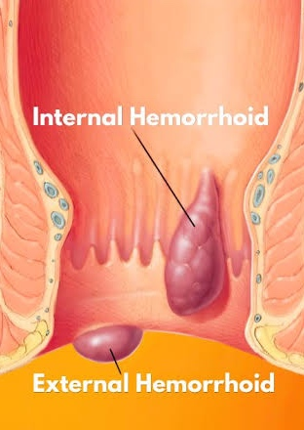
Hemorrhoids: overview
Hemorrhoids are abnormal progression of anal cushions (normal vascular structures in the anal canal that arise of the arteriovenous connective tissues that drains into the superior and inferior hemorrhoidal veins)
Three Types:
Internal: proximal to the dentate line
External: distal/below the dentate line
Mixed: straddle dentate line
Risk Factors: age, diarrhea, pregnancy, pelvic tumors, prolonged sitting, straining, chronic constipation

Slide 22
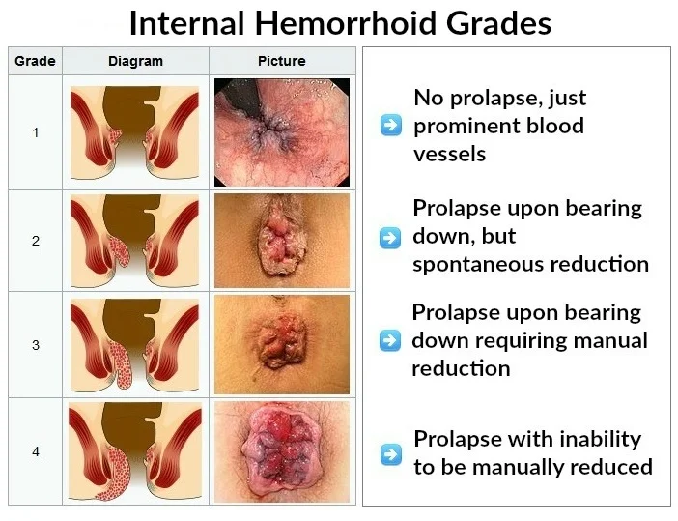
Hemorrhoids: Classifications
Internal Hemorrhoids:
Grade I: visualized on anoscopy and may bulge into the lumen but do not prolapse below dentate line
Grade II: prolapse out of the anal canal with defecation or with straining but reduce spontaneously
Grade III: prolapse out of the anal canal with defecation or straining and require manual reduction
Grade IV: are irreducible and may strangulate

Slide 23
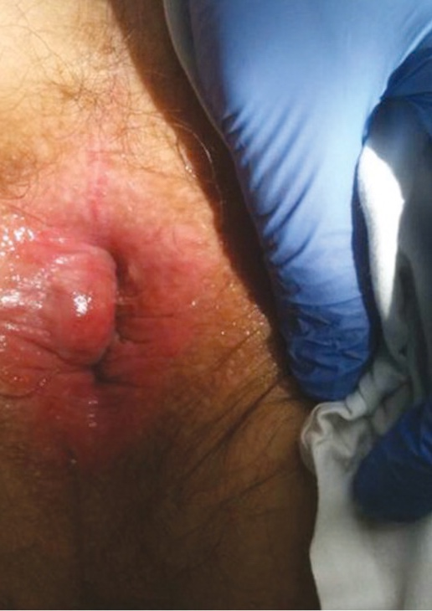
Hemorrhoids: Classification
External Hemorrhoids:
Distal or below dentate line
Close proximity to tissues innervated by spinal nerves - leads to more pain
Extremely painful when thrombosed
Mixed Internal and External
Straddle dentate line

Slide 24
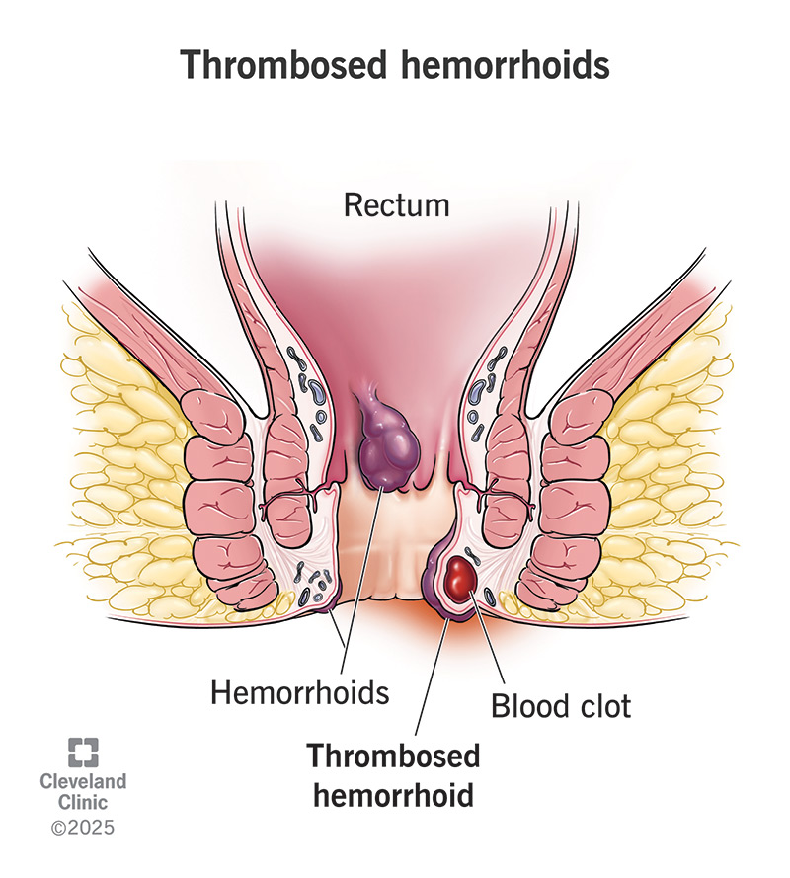
Hemorrhoids: Clinical Manifestations
40% of patients are asymptomatic
Perianal skin irritation and pruritus (internal)
Leakage of rectal contents (internal)
Painless Bleeding (BRBPR – hematochezia)
Thrombosis:
Acute perianal pain and a palpable ”lump”
More common in external hemorrhoids
Physical Exam:
DRE: internal hemorrhoids usually not palpable on exam
Thrombosed hemorrhoid = extreme tenderness to palpation
Anoscopy: internal hemorrhoids are bulging purplish-blue veins.

Slide 25

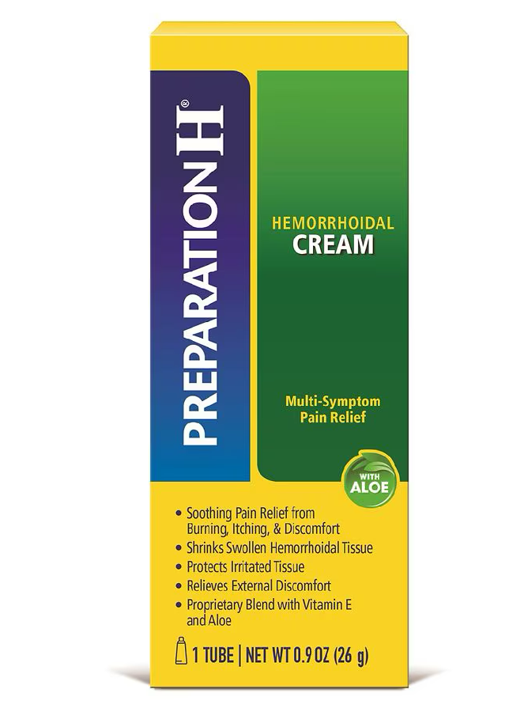
Hemorrhoids: Management
Management dependent on severity/grading
Asymptomatic patients: conservative treatment with diet management including high fiber/fluid intake
Grade I or II Internal Hemorrhoids:
Conservative treatment first: diet management
Topical Analgesics/Steroids: topical lidocaine-hydrocortisone ointment
Prep H: phenylephrine (vasoconstrictor), petrolatum, mineral oil
Sitz bath

Slide 26
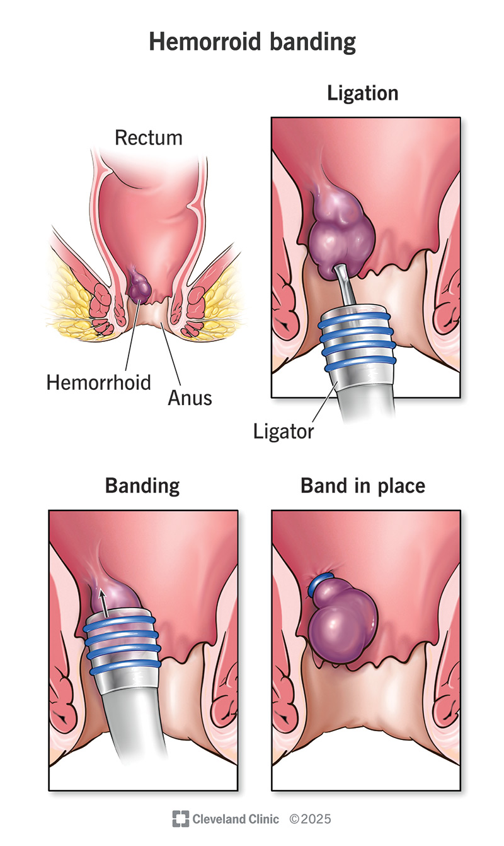
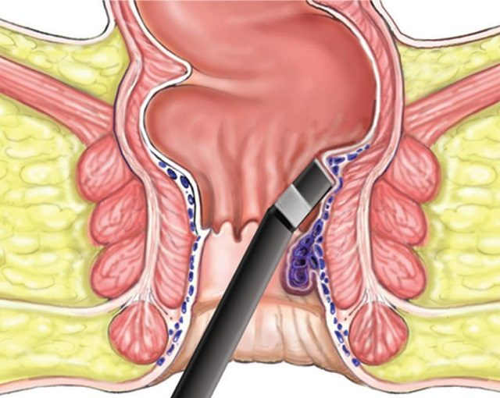
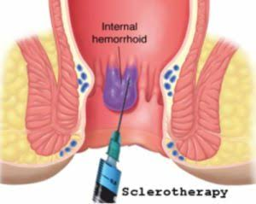
Hemorrhoids: management
Grade II or III: Refractory to conservative treatment
Rubber Band Ligation: most common (internal only). Contraindicated in patients with coagulopathies, on AC, or patients with a history of portal hypertension.
Sclerotherapy: process of injecting sclerosant solutions (phenol, polidocanol etc.) to treat internal hemorrhoids. High rate of recurrence with this method
Infrared coagulation: direct application of infrared light waves (heat) to the hemorrhoidal tissues. Has more recurrences compared to rubber band ligation, but less complications from procedure.

Slide 27
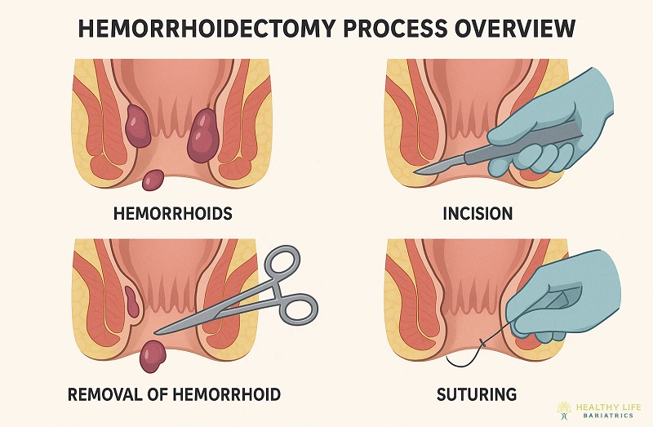
Hemorrhoids: Management
Grade IV:
Surgery when conservative management fails: surgical hemorrhoidectomy required
External Hemorrhoids:
Acute Thrombosed: office-based excision (if within the first three days of symptoms)
If extensive bleeding or severe pain may require OR excision.

Slide 28
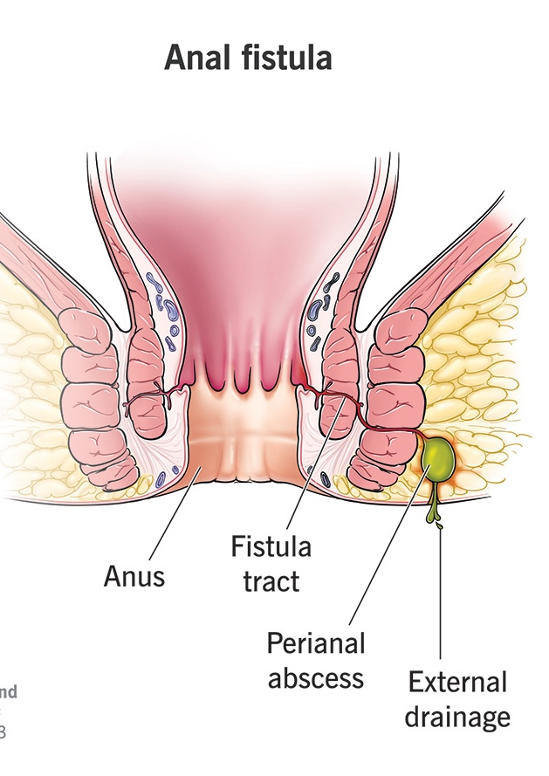
Anorectal Abscess/Fistula: overview
Anorectal abscess and fistulas are two different types of anorectal infections
Typically originates from an obstructed anal duct or crypt gland
Two Phases
Abscess: acute phase infection
Fistula: chronic phase of suppuration and fistulization (small tunnel connecting an infected gland inside the anal canal to the outer skin area)
50% of anorectal abscesses will result into a chronic fistula
Etiologies: infectious – Staph aureus (MC), E.coli, Proteus, Strep etc.

Slide 29
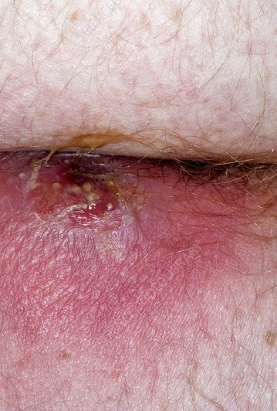
Anorectal Abscess/Fistula: Clinical Manifestations
Symptoms:
Abscess: severe/constant anal pain that is often worsened with sitting, coughing, and/or defecation. Posterior wall abscess MC site
Fistula: may cause anal discharge and pain
If serious infection/systemic: may have fever and or generalized malaise.
Physical Exam:
Area of fluctuance or a patch of erythematous, indurate skin overlying perianal skin. Patients with deeper abscess (eg, supralevator) may not have any PE findings and can only be observed via DRE/imaging (CT scan or MRI)
Purulent rectal drainage may be observed if abscess draining spontaneously.

Slide 30
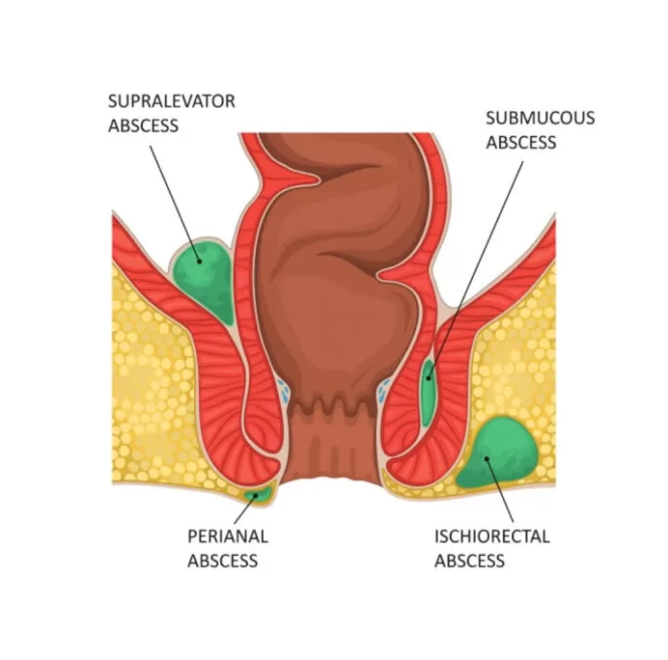
Perianal Abscess/Fistula: Clinical Manifestations

Slide 31
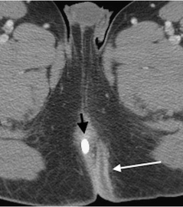
Anorectal Abscess/Fistula: Management
Surgical Drainage First Line!
If not drained, can lead to systemic infection
Antibiotics post surgical drainage
5-day course of Amoxicillin-Clavulanate (Augmentin) 875/125 every 8-12 hrs or Ciprofloxacin 500 mg BID + Metronidazole (Flagyl) 500mg every 8 hours.
WASH post-op:
Warm Water Cleansing
Analgesics (topical lidocaine)
Sitz Baths
High Fiber diet

Slide 32
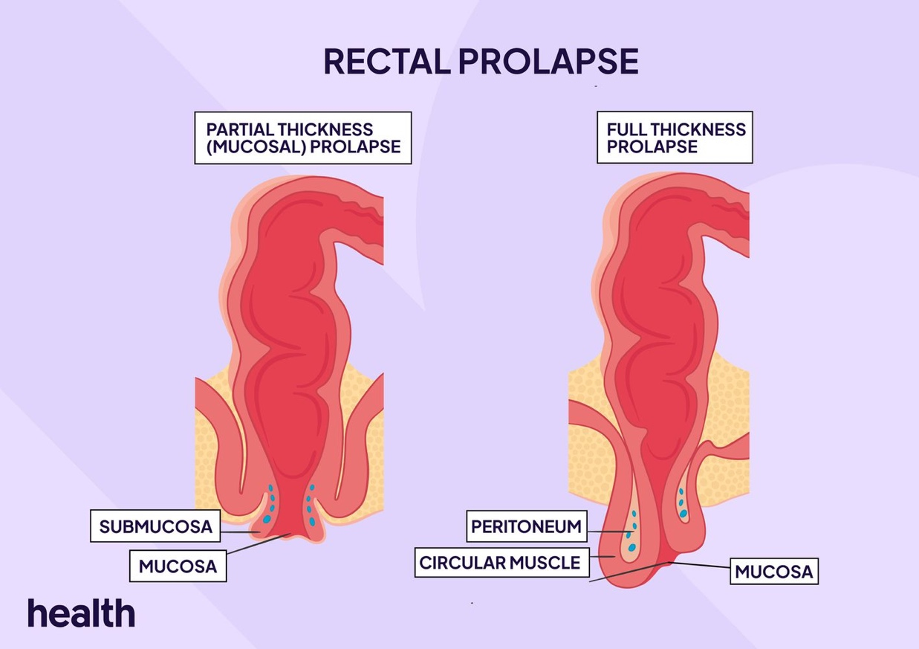
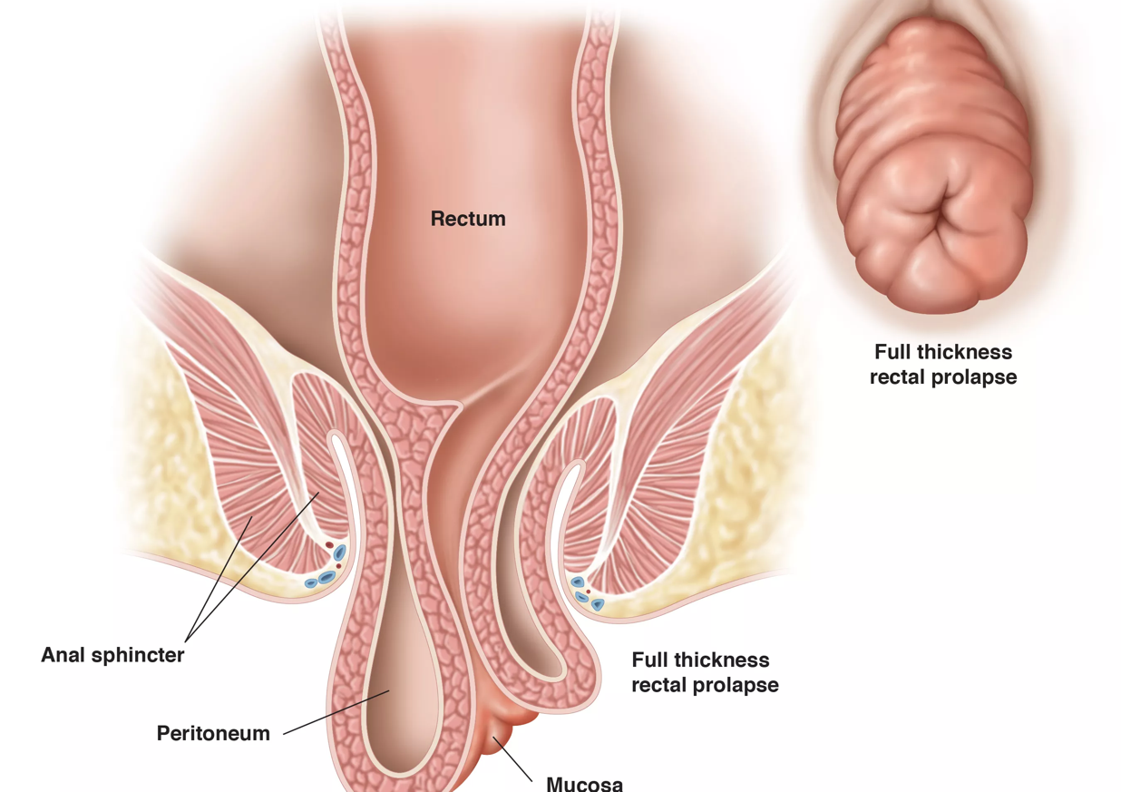
Rectal Prolapse: overview
Rectal Procidentia (prolapse): is a pelvic floor disorder most observed in women (can also occur in men)
Different Types:
Complete Rectal Prolapse: protrusion of all layers of the rectum through anus
Partial Rectal Prolapse: involves prolapse of the mucosa only
Occult Rectal Prolapse (rectal intussusception): telescoping of the bowel on itself without protruding through the anal verge (not a true prolapse)

Slide 33
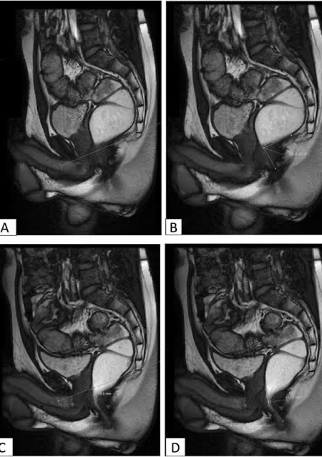
Rectal Prolapse: Clinical Manifestations/Management
Symptoms: abdominal discomfort, incomplete bowel evacuation, rectal wall protrusion, altered bowel habits
PE: MC sign is full-thickness protrusion of the rectum through the anus (must be differentiated from hemorrhoids etc.)
Diagnostics: colonoscopy (screen), Defecography (x-ray/MRI looking at pelvic floor muscles during defecation), anorectal physiological studies
Management: Surgical Repair (Rectopexy) – recurrence and enlargement over time common if not repaired
Can also utilize pelvic floor exercises

Slide 34
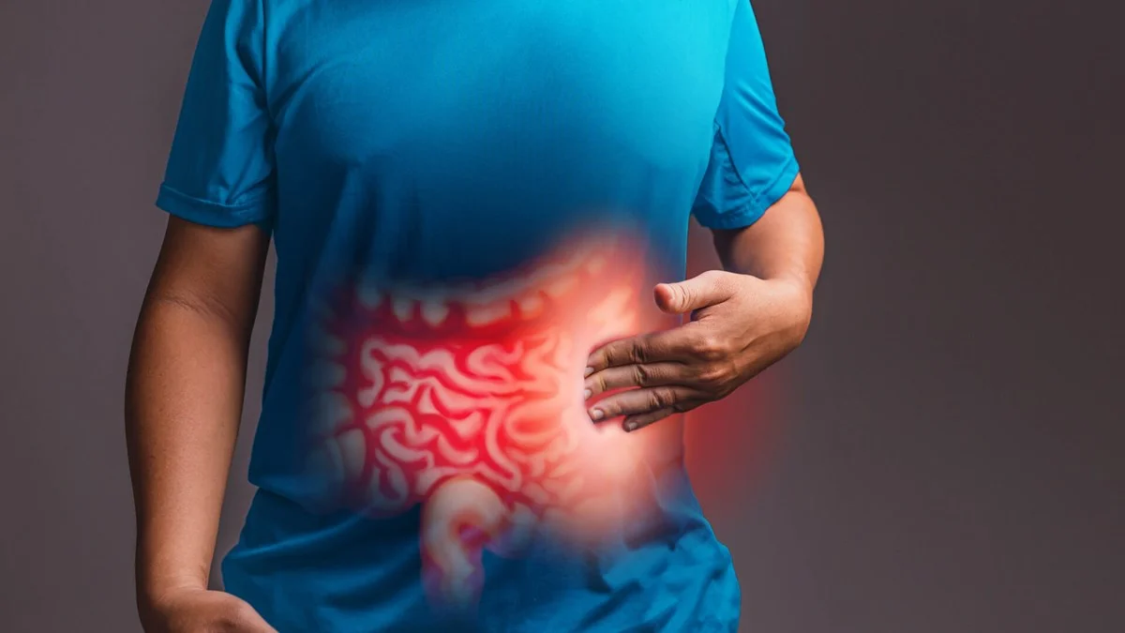
IRRITABLE BOWEL SYNDROME: OVERVIEW
IBS: disorder of brain-gut interaction resulting in abdominal pain and altered bowel habits.
Associated with other conditions: fibromyalgia, chronic fatigue syndrome, GERD, psychiatric disorders etc.
Symptoms usually begin between teens to early 20s. More common in woman than men.

Slide 35
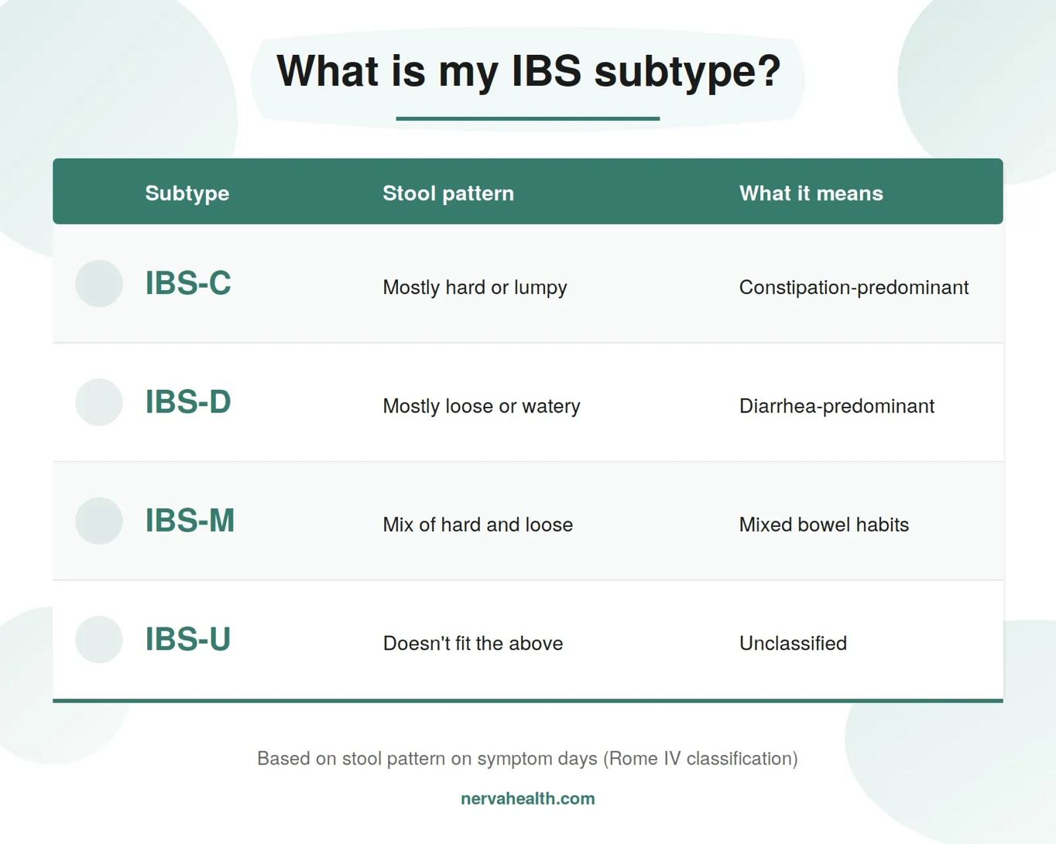
Irritable Bowel Syndrome: Clinical Manifestations
There are four different subtypes of IBS:
IBS-C: patient reports abnormal bowel movements are usually constipation
IBC-D: patient reports abnormal bowel movements are usually diarrhea
IBS-M: patient reports abnormal bowel movements are usually both constipation and diarrhea
IBS-U (unclassified): patient meets criteria for IBS, but doesn’t fit into the other subtypes
Symptoms: abdominal pain (cramping) – location varies, pain is usually associated with defecation (sometimes relieved with defecation). Can be exacerbated by stress and/or certain foods.

Slide 36
Irritable Bowel Syndrome: Clinical Manifestations
PE is usually benign – no major findings.
Diagnosis of exclusion: after other causes have been ruled (infection, celiac disease etc.)
Diagnostic Criteria: Rome V Criteria – IBS defined as recurrent abdominal pain on average at least 3 days per month in the past 3 months and associated with two or more of the following:
Related to defecation
Associated with a change in stool frequency
Associated with a change in stool form (appearance)

Slide 37

Irritable Bowel Syndrome: Management
First step is lifestyle modifications: low fat, high fiber diet. Avoid processed foods and spicy/foods that contain sorbitol or fructose.
Therapy dependent on which type of IBS:
IBS-C: Polyethylene Glycol (PEG), fiber, can add an osmotic laxative if no improvement. If no response, can proceed with Linaclotide or Lubiprostone if no response (increases intestinal chloride and fluid secretion)
IBS-D: Imodium, can add a bile acid sequestrant if no response (Cholestyramine). If still no response, can add an anticholinergic (Dicyclomine, Methscopolamine)
For other subtypes: based on what symptoms are present

Slide 38
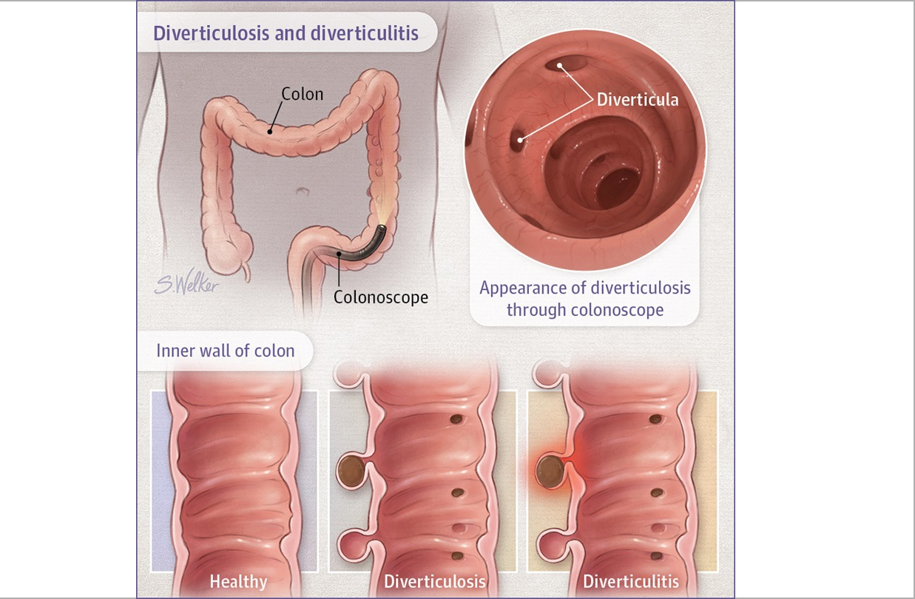
Diverticular Disease: Diverticulosis
Diverticula: sac-like protrusion of the colonic wall. Diverticulosis – presence of diverticular.
MC in the left colon. Right colon most common location for bleeding (has thinner walls)
Risk Factors: male sex, smoking, obesity, constipation, low fiber, increasing age.

Slide 39
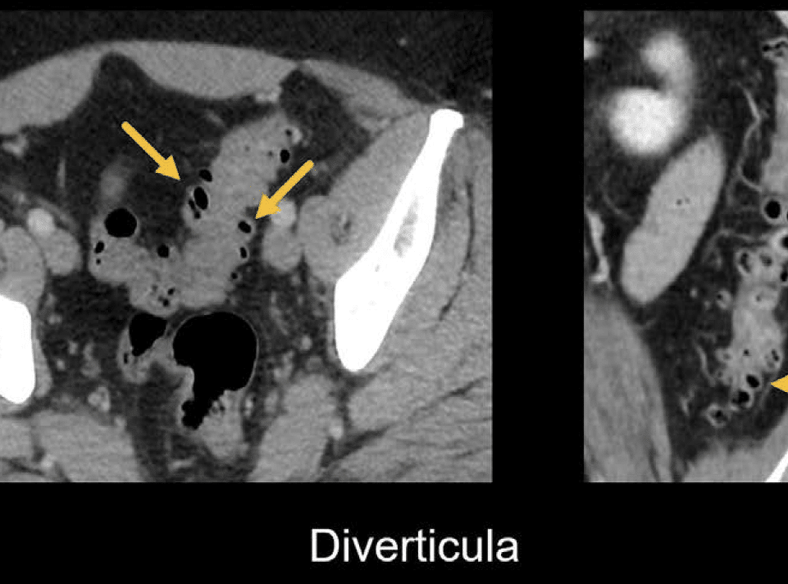
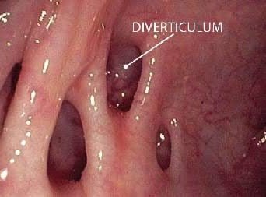
Diverticular Disease: diverticulosis
Clinical Manifestations:
Diverticulosis MC cause of ACUTE lower GI Bleeding (painless hematochezia)
Increased risk for patients with history of NSAIDS/Aspirin usage (WHY?)
Diagnostics:
Colonoscopy 1st Line (after upper GI bleed is r/o)
Radionuclide imaging (tagged RBC scan) - determines source of bleeding
Management:
Bleeding stops spontaneously most of the time
Lifestyle modifications: high fiber diet, psyllium
Endoscopic therapy if significant bleeding: utilize epinephrine injections

Slide 40
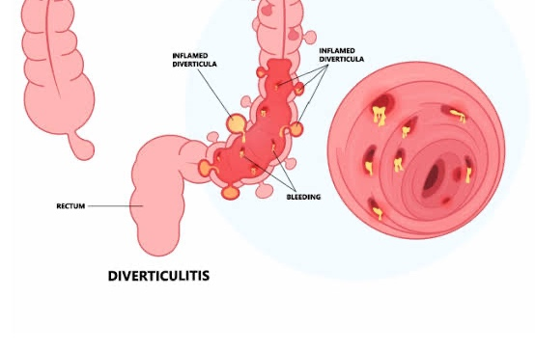
Diverticular Disease: Diverticulitis
Diverticulitis: inflammation/necrosis of the diverticula typically caused by micro/macroperforation
Sigmoid Colon MC location (high intraluminal pressure)
Clinical Manifestations:
LLQ Abd Pain
Nausea/Vomiting
Constipation or Diarrhea (change in bowel habit)
PE: LLQ tenderness, rebound tenderness, guarding, palpable if abscess has formed.
If perforation occurs: SEPSIS signs due to peritonitis

Slide 41
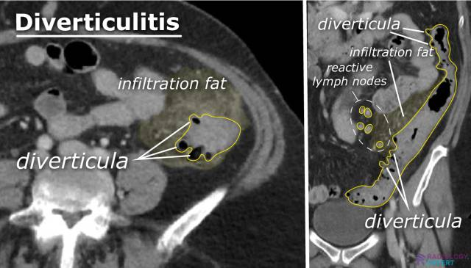
Diverticular Disease: Diverticulitis
Diagnostics:
CBC w/diff: Leukocytosis
CT SCAN w/Contrast 1st line Imaging: localized wall bowel wall thickening (>4mm), peri-clonic fat stranding d/t inflammation with presence of diverticula.
Stool studies r/o infection
Colonoscopy CONTRAINDICATED due to risk of perforation

Slide 42
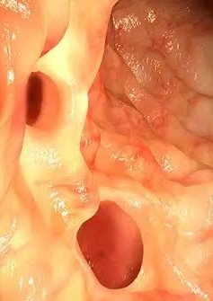
Diverticular Disease: Diverticulitis - Management
Most diverticulitis cases (around 70%) can be treated without medical management
Inpatient management meets following criteria:
CT shows COMPLICATED Diverticulitis: abscess, perforation, obstruction, fistula
CT shows UNCOMPLICATED Diverticulitis but the patient has 1 of the following:
Sepsis Criteria
Uncontrolled Abd Pain
>70 years old
Significant Comorbidities (DM, recent Cardio event, chronic liver disease, ESRD)
Immunosuppression (HIV, cancer patient, organ transplant etc.)
Intolerance of oral intake
Compliance Issues
Failed OP Treatment

Slide 43
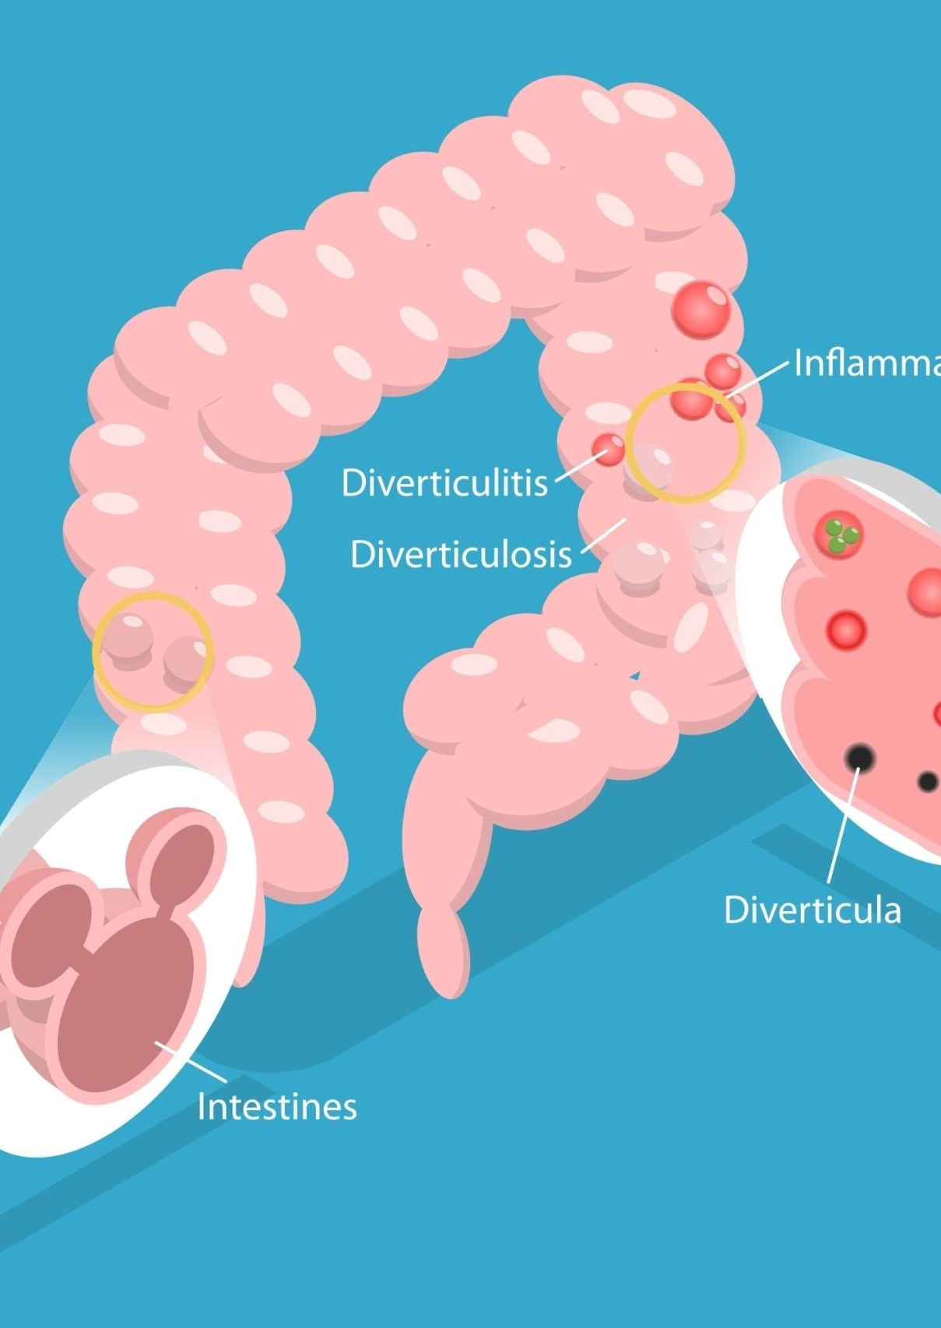
Diverticular Disease: Diverticulitis - Management
Uncomplicated Diverticulitis:
Can be treated outpatient
Antibiotics: PO Metronidazole (Flagyl) + Ciprofloxacin/Levofloxacin for 7-10 days
Recommend clear liquid diet and advance diet as tolerated
Complicated Diverticulitis:
Admit to inpatient.
If abscess present and >3-4cm, may need surgical drainage
IV Antibiotics: Metronidazole + Cipro/Levo or Zosyn (Piperacillin/Tazobactam) is an alternative.
Surgery indicated if refractory to medical treatment, recurrence, and or perforation

Slide 44
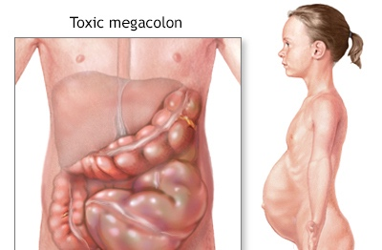
Toxic Megacolon: Overview
Toxic Megacolon: total or segmented non-obstructive colonic dilation that occurs in the context of systemic toxicity.
Etiologies:
IBS Complication/Ulcerative Colitis
Infectious colitis: CMV, C. difficile, Salmonella, Shigella, Campylobacter etc.
Radiation therapy
Colorectal Cancer

Slide 45
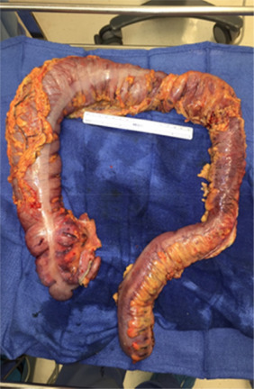
Toxic Megacolon: Clinical Manifestations
Symptoms:
Severe blood diarrhea
Abdominal Pain
Nausea/Vomiting
Tenesmus: strong, painful feeling that you need to empty your bowels
PE: lower abdominal tenderness with distention with additional signs of acute toxicity
Fever
Tachycardia
Hypotension
Dehydration
AMS
Peritonitis Signs: rigidity, guarding, rebound tenderness

Slide 46
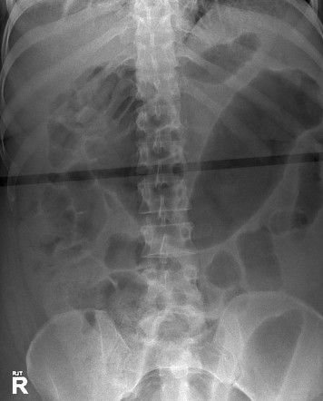
Toxic Megacolon: Clinical Manifestations
Diagnosis made with the following criteria:
Radiographic evidence of colonic dilation (diameter > 6cm) – can be observed on Abd X-ray and/or CT Scan A/P
Plus at least 3 of the following:
Fever > 38C
HR > 120 BPM
Neutrophilic Leukocytosis >10K
Anemia
Plus at least one of the following:
Dehydration
AMS
Electrolyte Disturbance
Hypotension

Slide 47
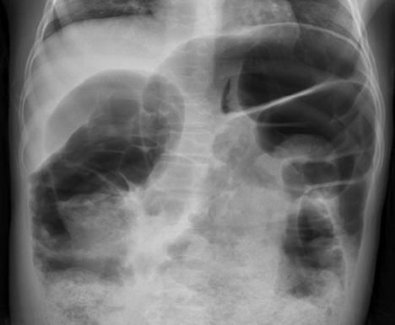
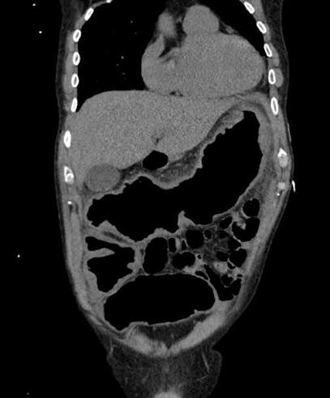

Toxic Megacolon: Clinical Manifestations

Slide 48

Toxic Megacolon: Management
Supportive Therapy:
IV Fluids/Electrolyte Replacement
Bowel Rest (NPO)
Broad spectrum IV Antibiotics (Ceftriaxone + Flagyl)
NGT Placement (Bowel Decompression)
Avoid antimotility agents (opioids, anticholingergics etc.)
Treat Underlying Cause:
Ulcerative Colitis: IV Steroids
CMV Colitis: IV Ganciclovir
C-diff Colitis: Oral Vancomycin/Fidaxomicin 3
If colonic perforation (Peritonitis/SEPSIS!): emergent surgery – partial or total colectomy

Slide 49


Toxic Megacolon: Management

Slide 50

Inflammatory Bowel Disease: Overview
Inflammatory Bowel Disease is comprised of two major disorders including Ulcerative Colitis and Crohn Disease
Risk Factors
Race/Ethnicity: more common in Jewish population, increased in Caucasians vs Hispanics/African population
Onset: 15-35 years old (UC more common in males, CD more common in females)
Genetics: 10-30% have family history (1st degree)
Smoking history higher risk for Crohn’s
Dietary factors: low fiber diet
History of GI infections
Medications: NSAIDs, oral contraceptives, HRT

Slide 51

Inflammatory Bowel Disease: Overview
Crohn Disease: idiopathic inflammatory bowel disease
Transmural (entire wall) Inflammation that can affect any part of GI tract
Inflammation can lead to fistulas, bowel strictures, abscesses, fibrosis, bowel obstruction
Characterized by segments of normal-appearing bowel with areas of disease
Terminal Ileum MC segment involved (Rectum is usually spared)
Ulcerative Colitis: chronic inflammation of the colon
Inflammation limited to the mucosal/submucosal layers
Involves the rectum and extends proximally to the colon in a continuous circumferential pattern
40-50% are limited to the rectum/rectosigmoid areas

Slide 52
Inflammatory Bowel Disease: Clinical Manifestations
Crohn Disease
Ulcerative Colitis
Crampy Abd. Pain
Chronic/Persistent Diarrhea without gross blood
Fatigue/Weight Loss (Malabsorption)
Electrolyte Abnormalities (vitamin b12 deficiency, hypocalcemia etc.)
Ileocolitis: RLQ pain, diarrhea, fatigue, weight loss, fever, anorexia
Severe cases: perianal disease, abscess, fistula etc.
Hematochezia (gross bright red/marron blood)
Diarrhea with blood
Abd. Pain (LLQ)
Increased Urgency
Tenesmus
Systemic symptoms if infectious: fever, fatigue, malaise, weight loss etc.

Slide 53

Inflammatory Bowel Disease: Clinical Manifestations

Slide 54

Inflammatory Bowel Disease: Clinical Manifestations
Diagnostics for Crohn Disease:
Ileocolonoscopy with biopsy: segmental areas, cobblestoning of mucosa, aphthous focal ulcerations, strictures
Biopsy: transmural inflammation, focal lesions with or without noncaseating granulomas (small clusters of immune cells)
Imaging: Enterography MRI preferred – avoids radiation and has comparable diagnostic accuracy
Labs: + anti-Saccharomyces cerevisiae antibodies, iron/B12deficiency, elevated CRP/ESR

Slide 55


Inflammatory Bowel Disease: Clinical Manifestations
Diagnostics: Ulcerative Colitis
Flexible Sigmoidoscopy/Colonoscopy: colonoscopy should be avoided in patients having a severe flare (WHY?)
Flex Sig: shows uniform mucosal erythema, granularity, and ulceration
Biopsy: non-specific – abscess of atrophy/inflammation, goblet depletion. Infiltration of mucosal layers (can see lymphocytes, plasma cells etc.)
Double Contrast Barium Enema: stovepipe/lead pipe sign – cylindrical bowel with loss of haustral markings (folds of large intestine)
Labs: + p-ANCA (perinuclear anti-neutrophil cytoplasmic antibodies), elevated ESR/CRP, anemia of chronic disease, leukocytosis (if severe inflammation or infection)

Slide 56

Inflammatory Bowel Disease: Management
Crohn Disease Treatment: these are autoimmune processes – we need to control the immune system!
Step up approach and dependent on which portion of the colon is involved
Limited/Right Colon Disease: oral glucocorticoids – Prednisone/Budesonide, can also utilize oral 5-aminosalicylates (Mesalamine)
Left Sided Colon: oral glucocorticoids (Budesonide, Prednisone)
Taper medications over time (why do we not want them to stay on these medications forever?)
Severe/Refractory Disease: aggressive approach
Immunomodulators: (Azathioprine, 6-Mercaptourine, Methotrexate (MRX))
Biological Therapy: anti-TNF agents (Adalimumab, Infliximab etc.)
Adequate follow up: repeat Flex Sig/Colonoscopy in 6-12 months, close monitoring of acute flares

Slide 57

Inflammatory Bowel Disease: Management
UC Treatment: these are autoimmune processes – we need to control the immune system!
Again, dependent on location/severity
Mild to Moderate Right Colon:
Topical 5-ASA (aminosalicylic acid (ASA) 1st line – rectal Mesalamine suppository
If no improvement: add topical glucocorticoid (suppository), then oral 5-ASA, then oral steroids if no improvement.
Left Sided or Extensive Colitis:
Combination therapy up front: Oral 5-ASA (standard or high dose Mesalamine, Sulfasalazine, or Balsalazide) + Topical (Rectal) 5-ASA
If no improvement: add Topical glucocorticoid, then add Budesonide MMX (if still no response, proceed with Oral Steroids)
Refractory to steroids – then may need to add anti-TNF, anti-integrin therapy (Vedolizumab).
For severe colitis with sever bleeding in hospitalization: use IV Steroids!

Slide 58

Acute Mesenteric Ischemia: Overview
Acute Mesenteric Ischemia: sudden stop in small intestine blood flow caused by one of the following:
Acute Arterial Occlusion: caused by embolism (A-fib MC, atherosclerosis), superior mesenteric artery MC occlusion location
Non-Occlusive: low flow rate due to sepsis/shock, MI, CHF (arterial vasospasm - cocaine)
Venous Thrombus: due to obstruction of intestinal venous outflow most commonly caused by hypercoagulable states (Factor V), malignancy, prior abd. Surgery
60-70% of all mesenteric ischemia in adults
High mortality rate: around 60 %

Slide 59

Acute Mesenteric Ischemia: Clinical Manifestations
Symptoms:
Arterial thrombus: sever abdominal pain out of proportion to PE findings
Poorly localized pain
Nausea/Vomiting/Diarrhea
Physical Exam:
Limited findings on exam – sever abdominal tenderness
Advanced stage: peritonitis (SHOCK/SEPSIS) signs

Slide 60


Acute Mesenteric Ischemia: Clinical Manifestations
Diagnostics:
CTA (Angiography) 1st line if stable (without oral contrast)
Catheter-based arteriography = confirmation diagnostic and therapeutic – allows lesion visualization and modality for intervention (vasodilators, angioplasty, thrombolytic)
Labs: leukocytosis, Lactic Acidosis elevated, increased LDH

Slide 61

Acute Mesenteric Ischemia: Management
Need RAPID REVASCULARIZATION – involves restoration of blood flow and likely excision of necrotic bowel if needed
Embolism: early surgical laparotomy with embolectomy and or thrombolytics
Arterial thrombosis: surgical revascularization with aortomesenteric bypass or endovascular balloon dilation angioplasty with stent
Mesenteric Venous thrombosis: systemic AC or thrombolytics
Perforation/Peritonitis: EMERGENCT surgical exploration (laparotomy) with likely bowel resection and revascularization

Slide 62

Chronic Mesenteric Ischemia: Overview
Chronic Mesenteric Ischemia: reduced blood flow to small bowel due to atherosclerotic narrowing of 2-3 major splanchnic vessels (celiac axis, superior mesenteric artery, or inferior mesenteric artery)
Typically caused by hypoperfusion d/t eating (decrease blood flow to affected regions)
Risk Factors: Atherosclerosis (hx of MI, stroke etc.), DM, HTN, smoking etc.

Slide 63

Chronic Mesenteric Ischemia: Clinical Manifestations/Management
Symptoms: Abd. Pain (chronic, dull pain that is worse after meals), anorexia, weight loss
PE: mild tenderness to palpation, Abdominal Bruit in up to 50% of cases
Diagnostics: CTA 1st line imaging
Conventional Angiography: confirmatory diagnostic
Management:
Asymptomatic Patients: lifestyle changes (smoking, DM etc.) anti-platelet therapy
Symptomatic: revascularization (open or endovascular) with bypass and/or stenting

Slide 64

Ischemic Colitis: Overview
Ischemic Colitis: ischemic injury to the colon due to reduced blood flow
Mostly occur in the elderly (90% are 60+)
Typically occurs in ”watershed areas” with limited collateral blood supply
Ischemia usually occurs mucosal and not transmural
Etiologies:
Non-Occlusive (95%): due to systemic hypotension or atherosclerosis of the superior/inferior mesenteric arteries
Embolus/Thrombosis occlusion: less common
Risk Factors: age, DM, CAD, HLD, hypercoagulable states, constipation meds, dehydration

Slide 65

Ischemic Colitis: Clinical Manifestations
Symptoms: rapid onset of abdominal pain over the affected region (left sided and LLQ MC), bloody diarrhea within 24hrs of onset of pain (colonic sloughing – WHY?)
PE: abdominal tenderness to affected area (often lateral)
Diagnostics:
CT Abdomen/Pelvis: 1st line imaging – wall edema and ”thumbprinting” (segmental bowel wall thickening and edema in a non-segmental pattern), double halo/target sign: two continuous thickened layers
Sigmoidoscopy/Colonoscopy: CONFIRMS diagnosis (contraindicated if high risk or active perforation)

Slide 66


Ischemic Colitis: Management
Supportive Care First: most patients respond
Restore Prefusion if possible
Bowel Rest (NPO)
IVF
Consider ABX
Close monitoring for perforation/peritonitis
If colon infarction occurs with concern for necrosis: surgical intervention with colon resection if indicated

Slide 67

Colonic Polyps: Overview
Colonic Polyp: refers to a protuberance into the lumen of the surrounding colonic mucosa.
Colon polyps are typically asymptomatic, but can bleed and potentially can cause an obstruction.
There are a few different types of polyps. Some have a higher associated with malignancy.

Slide 68


Colonic Polyps: Clinical Manifestations
Inflammatory Polyps: non-neoplastic intraluminal projections of mucosa consisting of stromal and epithelial components and inflammatory cells.
Pseudopolyps: type of inflammatory polyp that are irregular shaped islands of residual intact colonic mucosa as the result of ulceration and regeneration (UC and Crohn Disease)
Serrated Polyps: heterogenous group of polyps with variable malignant potential.
Hyperplastic polyps: MC type of non-neoplastic polyp in the colon.
Sessile Serrated Lesions (SSLs) and Traditional Serrated Adenomas (TSA): increased risk of colon cancer

Slide 69

Colonic Polyps: Clinical Manifestations
Adenomatous Polyp: MC type of Malignant polyp (2/3 of all colonic polyps)
Tubular Adenomas: characterized by a network of branching adenomatous epithelium. MC type AP. Least risk of malignancy of this sub-group. Risk of malignancy correlates with size (>10% if >2.5 cm in diameter)
Villous: characterized by glands that are long and extend straight down the surface to the center of the polyps. HIGHEST risk of malignancy. More prominent on the left side of colon.
Tubovillous (mixture): account for 5-10% of colonic adenomas. Intermediate risk of malignancy.

Slide 70
Colonic Polyps: Management
If a polyp is detected, a colonoscopy is warranted to establish histology, remove the polyp, and search for other lesions.
For all Adenomas: resection is required! (polypectomy). Incomplete resection of the polyp can increase risk of malignancy. Must ensure margins are free of neoplastic tissue.
Surveillance is required for these patients:
F/U Colonoscopy in 3 months post polypectomy
For patients with advanced adenomas (Tubular adenoma >10mm or villous histology/High Grade Dysplasia): first surveillance colonoscopy at 3 years. If no adenomas, then 5 year follow up colonoscopy. If three to four tubular adenomas <10mm, then colonoscopy 3-5 years. If advanced adenoma or 5-10 adenomas <10mm, then next colonoscopy in 3 years.
For patients without advanced adenomas: first surveillance colonoscopy between 7-10 years.

Slide 71

Colorectal Malignancies: Overview
Colorectal cancer is the third most common cause of cancer-related death in the U.S. in women (2nd in men).
About 147,000 new cases each year with about 53,000 deaths due to colorectal cancer per year
Good news is the overall death rate has been declining since the 1990s, thanks treatments and screenings
However, CRC has been increasing (approx. 2.1%) per year in individuals under the age of 50 (more younger patients affected)
Histology:
Adenocarcinomas (85%)
Mucinous (12%)
Sigmoid (best OS rate)

Slide 72

Colorectal Malignancies: Risk Factors
Overweight/obese
Not being physical active
Diet: processed meats!
Diabetes
Smoking
Alcohol
Prior hx of adenomatous polyps (adenomas)
Personal history of IBS

Slide 73

Colorectal Malignancies: Risk Factors
Family Hx of Colorectal Syndromes
Lynch Syndrome (hereditary non-polyposis colon cancer syndrome)
Approximately 20% of CRC diagnosis have family hx
Autosomal dominant disorder (gene mutation)
MC colorectal cancer susceptibility syndrome
Accounts for approximately 2-3% of CRC
Should be suspicious for syndrome in patients who are diagnosed with CRC younger than age 50 (also in patients with endometrial, ovarian, stomach, renal pelvis/ureter malignancies)
Confirmation is done via genetic testing
Screenings should start at 20-25 years old (every 1-2 years)

Slide 74


Colorectal Malignancies: Risk Factors
Family Hx of Colorectal Syndromes
Familial Adenomatous Polyposis (FAP)
Gene mutation (APC gene) causing hundreds to thousands of colon polyps beginning at the age of 10-12 years of age
Cancer usually develops in 1 or more of these polyps by the age of 20
ALL PATIENTS WILL EVENTUALLY DEVELOP CANCER
Three different Subtypes:
Attenuated FAP (AFAP): patient who have few polyps (<100)
Gardner Syndrome: type of FAP that causes non-cancer tumors of the skin, soft tissue, bone
Turcot Syndrome: rare condition, highest risk, high number of polyps
Screening (Flex/Sig) should start at 10-12 years old

Slide 75


Colorectal Malignancies: Risk Factors
Family Hx of Colorectal Syndrome:
Peutz-Jeghers Syndrome (PJS): rare syndrome caused by a mutation in STIK11 (LKB1) gene
Patients have special type of polyp (hamartomas) in their digestive tract that places them at very high risk for CRC (also breast, ovarian, and pancreatic cancer)
Usually diagnosed at younger age
Patient tend to have freckles around the mouth (also sometimes hands/feet)

Slide 76


Colorectal Malignancies: Screening
Screening based on age/family hx
Two main tools: FIT (fecal Immunochemical test) which tests for hidden blood in the stool, also colonoscopy
Avg. Risk Patients
Initiate screening at age 45 through age 75
Colonoscopy every 10 years (some opt for sigmoidoscopy only)
Annual FIT test

Slide 77


Colorectal Malignancies: Screening
High Risk Patients: Family hx (Lynch Syndrome, FAP)
If FDR (first degree relative has a hx): initiate screening at age 40 (or 10 years earlier when relative was diagnosed, whichever is earliest)
Screen with colonoscopy every five years
FIT screening annually (especially if the patient declines a colonoscopy)
Patients with hx of Inflammatory Bowel Disease: should start screening around 8-10 years from diagnosis

Slide 78

Colorectal Malignancies: Clinical Manifestations
One in five patients present with metastatic disease
Mets most common in the liver, but also includes lungs, and peritoneum
Signs/Symptoms
Hematochezia (Melena)
Abdominal Pain
Unexplained iron deficiency anemia
Change in bowel habits (MC symptom 74%)
Ascites/Hepatomegaly (usually with liver involvement)

Slide 79

Colorectal Malignancies: Clinical Manifestations
Signs/symptoms often varies on tumor location/disease progression
Change in bowel habits is more often associated with left sided tumors (also obstruction)
Hematochezia more often associated with rectosigmoid tumor (right-sided tumors)
Iron deficiency anemia more often associated with right sided tumors
Abdominal pain usually presents in all tumor locations
Rectal cancer: can cause tenesmus, rectal pain
Patients who present with symptoms usually have progressive disease (worse prognosis)

Slide 80

Colorectal Malignancies: Diagnostics
As already discussed, Colonoscopy with biopsy is going to be diagnostic of choice
CT Scan: also can be utilized in patients with generalized abdominal symptoms
Flex Sigmoidoscopy: has increased in usage over the past 50 years, but has limitations (most effective for palpable masses felt in the rectum)
CT Colonography: uses CT scan and bowel preparation to visualize colon
More often used when there is an incomplete colonoscopy

Slide 81

Colorectal Malignancies: Diagnostics
Tumor Markers
Two markers associated with CRC include: carcinoembryonic antigen (CEA) and carbohydrate antigen 19-9 (CA 19-9)
Both don’t have the best specificity and should NOT be used as screening tools
CEA levels have usage for follow up patients with already diagnosed CRC
Higher levels of CEA (>5ng/mL) preoperative have worse prognosis
Maintain levels of CEA or increasing levels s/p surgery, often indicate aggressive disease

Slide 82

Colorectal Malignancies: Staging
https://cancerstaging.org/references-tools/quickreferences/documents/colonmedium.pdf

Slide 83


Colorectal Malignancies: Staging
In addition to colonoscopy/biopsy:
CT TAP (Thorax/abd/pelvis): often utilized to look for metastasis
PET scan: usually not utilized (doesn’t usually add too much information not seen on CT)
Tumor Markers: CEA levels are usually obtained pre/post operation and aid in treatment planning/prognosis
Additional testing:
MRI of Liver
DRE (digital rectal examination)
Transrectal US
Often used for candidates for radiotherapy/chemoradiotherapy

Slide 84

Colorectal Malignancies: Treatment/Management
STAGE | SURGERY | CHEMOTHERAPY / BIOLOGICS | RADIATION | INTERVENTIONAL RADIOLOGY
Stage 0 | Yes | No | No | No
Stage 1 | Yes | No | No | No
Stage 2 | Yes | Yes, for rectal and high risk colon cancers. FOLFOX (5-FU/Leucovorin/Oxaliplatin) or CapeOx (Capecitabine/ Oxaliplatin) | Yes, for rectal cancer. Given in tandem with 5-FU or Xeloda | No
Stage 3 | Yes | FOLFOX or CapeOx | Yes, for rectal cancer. Given in tandem with 5-FU or Xeloda | No
Stage 4 | Yes, if the tumor is obstructive or blocking the bowel. No, if the tumor is not blocking the bowel | FOLFOX, FOLFIRI, FOLFIRINOX, Irinotecan, Avastin, Erbitux, Vectibix, Zaltrap, Stivarga, Lonsurf, Cyramza | Yes, for rectal cancer and in certain other cases | Possibly. Options could be Radio Frequency Ablation (RFA), Stereotactic Body Radiation Therapy (SBRT), or chemoembolization
https://www.ccalliance.org/colorectal-cancer-information/treatments

Slide 85

Colorectal Malignancies: Treatment/Management
Surgical Resection
Approximately 80% of localized cancers use surgery as potential cure (can also have lymph node involvement)
Some patients require colostomy/ileostomy if bowel perforation is present
Chemotherapy/Radiation
Often used in patients who do have unresectable disease
Combination can also be used in patients pre/post surgery to ensure all potential local metastasis is resolved

Slide 86

Colorectal Malignancies: Treatment/Management
Chemotherapy
Adjuvant Therapy: given after surgery
Neoadjuvant: given prior to surgery in combination with RXT
Common Chemotherapies include:
5-FU (Flurorouracil)
Capecitabine (Xeloda)
Irinotecan (Camptosar)
Oxaliplatin (Eloxatin)
Side effects: hair loss, mucositis, n/v/d, loss of appetite, weight loss , neuropathy
Hand-Foot Syndrome (redness of hands/feet): seen with 5-FU and Capecitabine

Slide 87

Colorectal Malignancies: F/U and Prognosis
Most important prognostic factor is staging
Post Surveillance treatment: depends on which guidelines are being followed
History and Physical every 3 to 6 months for five years
Serum CEA testing every 3 to 6 months for five years
CT TAP: every year for three to five years
Colonoscopy at one year, then every 5 years

Slide 88

Anal Malignancies: overview
Anal cancer comprises about 2.5% of all digestive cancers (approximately 8590 new cases in the U.S.)
Has been increasing over the last 30 years
Usually refers to squamous cell cancer (SCC)
Risk Factors:
Female Gender
HPV hx
Lifetime number of sexual partners
Genital Warts
Smoking
Anal Intercourse
HIV

Slide 89

Anal Malignancies: Clinical Manifestations
Signs/Symptoms:
Rectal Bleeding: MC initial symptom (occurs in approximately 45% of patients)
Anorectal pain/sensation of mass (30%)
Constipation
Diarrhea
Discharge
Pruritus
Tenesmus

Slide 90

Anal Malignancies: Staging/Diagnostics
Additional Testing Often Includes:
Biopsy of Tumor
CT TAP
PET/CT scan
CEA tumor markers NOT routinely tested in these patients

Slide 91


Anal Malignancies: Staging/Diagnostics

Slide 92


Anal Malignancies: Treatment/Follow up
Chemoradiotherapy has emerged as the preferred method of treatment because it can preserve the anal sphincter in 70-85% of cases
Combination regimens usually includes: Fluorouracil (FU) + Mitomycin + Radiation
Local excision is also an option in selected patients usually when lesion is <1cm. Vigilant follow up is usually required
Treatment response should be re-evaluated every 8 to 12 weeks after chemoradiation is completed
Digital Rectal Exams (DRE): every 3-6 months five years
CT or PET scan: annually for 3 years

Slide 93

Anal Malignancies: Prognosis
Prognosis based on staging:
Palpable, clinically positive lymph node and male sex are poor prognostic factors
Anal margin tumors are generally more favorable than canal (less involvement)
Overall Survival:
60% in men
71% in women
At earliest stage, 82%
Lymph node involvement, approx. 60%

